Slide 1
Plastics

Slide 2
Plastics or polymer
Definition: A group of engineered materials characterized by large molecules that are built up by the joining of smaller molecules.
They are natural or synthetics resins.

Slide 3
Properties of plastics
Light weight
Good resistance to corrosion
Easy of fabrication into complex shapes
Low electrical and thermal conductivity
Good surface finish
Good optical properties
Good resistance to shock and vibration.

Slide 4
IES 2010
Consider the following properties for plastics:
1. Become hard on heating.
2. Increasing plasticity.
3. Ability to deform with rise in temperature.
4. Long chain structure.
Which of these properties for plastics are correct?
(a) 1, 2, 3 and 4 (b) 3 and 4 only
(c) 1 and 4 only (d) 2, 3 and 4 only
Notes:
Ans. (d)

Slide 5
IES 2010
Plastic material is used for the component which requires characteristics of
(a) Low density, machinability and high strength
(b) Machinability, high strength and large plastic deformation
(c) High strength, large plastic deformation and low density
(d) Low density, machinability and large plastic deformation
Notes:
Ans. (d)

Slide 6
IAS-2007
Consider the following:
Which of the following properties are possessed by plastics?
Good resistance to corrosive atmosphere
Ease of fabrication into complex shapes.
Good resistance to shocks and vibrations.
Select the correct answer using the code given below:
(a) 1, 2 and 3 (b) 2 and 3 only
(c) 1 and 3 only (d) 1 and 2 only
Notes:
Ans. (a)

Slide 7
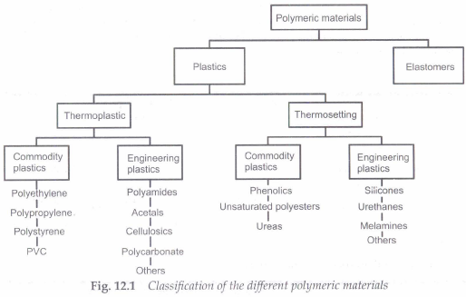

Slide 8
IES-2008
Structure of a polymer is:
(a) Long chain (b) Rhombic
(c) Cubic (d) Closed pack hexagonal
Notes:
Ans. (a) Polymers:
Commercially called plastics; noted for their low density, flexibility and use as insulators.
Mostly are of organic compounds i.e. based on carbon, oxygen and other nonmetallic elements.
Consists large molecular structures bonded by covalent and van der Waals forces.
That is why structure of polymer is long chain.

Slide 9
Classification – Polymers
Classification based on their industrial usage:
plastics and
elastomers.
Classification based on their temperature dependence:
(a) thermoplasts and
(b) thermosets

Slide 10
Thermoplasts
Plastics which softens up on heating and hardens up on cooling where the softening and hardening are totally reversible processes.
Hence thermoplasts can be recycled.
They consist of linear molecular chains bonded together by weak secondary bonds or by inter-winding.
Cross-linking between molecular chains is absent in theromplasts.
E.g.: Acrylics, PVC, Nylons, Perspex glass, etc.

Slide 11
Thermoplastics
Acrylonitrile-butadiene-styrene (ABS):
Characteristics: Outstanding strength and toughness, resistance to heat distortion; good electrical properties; flammable and soluble in some organic solvents.
Application: Refrigerator lining, lawn and garden equipment, toys, highway safety devices.
Acrylics (poly-methyl-methacrylate) PMMA
Characteristics: Outstanding light transmission and resistance to weathering; only fair mechanical properties.
Application: Lenses, transparent aircraft enclosures, drafting equipment, outdoor signs.
Contd…

Slide 12
Fluorocarbons (PTFE or TFE,Teflon)
Characteristics: Chemically inert in almost all environments, excellent electrical properties; low coefficient of friction; may be used to 260oºC; relatively weak and poor cold-flow properties.
Application: Anticorrosive seals, chemical pipes and valves, bearings, anti adhesive coatings, high temperature electronic parts.
Polyamides (nylons)
Characteristics: Good mechanical strength, abrasion resistance, and toughness; low coefficient of friction; absorbs water and some other liquids.
Application: Bearings, gears, cams, bushings, handles, and jacketing for wires and cables.
Contd…

Slide 13
Polycarbonates
Characteristics: Dimensionally stable: low water absorption; transparent; very good impact resistance and ductility.
Application: Safety helmets, lenses light globes, base for photographic film
Polyethylene
Characteristics: Chemically resistant and electrically insulating; tough and relatively low coefficient of friction; low strength and poor resistance to weathering.
Application: Flexible bottles, toys, tumblers, battery parts, ice trays, film wrapping materials.
Contd…

Slide 14
Polypropylene
Characteristics: Resistant to heat distortion; excellent electrical properties and fatigue strength; chemically inert; relatively inexpensive; poor resistance to UV light.
Application: Sterilizable bottles, packaging film, TV cabinets, luggage
Polystyrene
Characteristics: Excellent electrical properties and optical clarity; good thermal and dimensional stability; relatively inexpensive
Application: Wall tile, battery cases, toys, indoor lighting panels, appliance housings.
Contd…

Slide 15
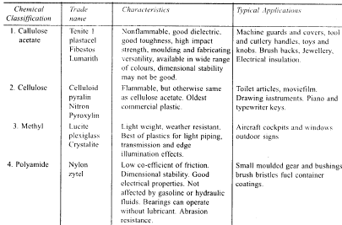

Slide 16
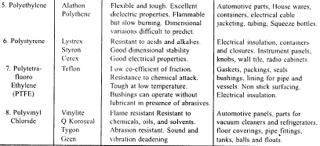

Slide 17
IES 2011
Windows of aeroplane are made of :
(a) PVC
(b) PTFE
(c) PMMA
(d) PEEK
Notes:
Ans. (c)

Slide 18
IES-2003
Teflon is a
(a) Thermosetting fluorocarbon polymer
(b) Thermo-plastic fluorocarbon polymer
(c) Inorganic compound of fluorine and carbon
(d) Laminated phenolic material
Notes:
Ans. (b) Remember it.
Thermoplast: Thermoplast have the property of increasing plasticity that is increasing ability to deform plastically with increasing temperature.
Thermosets: It has a three dimensional network of primary bonds. They are relatively hard and rigid at room temperature and do not soften on heating.

Slide 19
IES-1992
Polyamides are characterized by
(a) Flexible chain
(b) Rigid chain
(c) Amorphous structure
(d) Crystalline structure
Notes:
Ans. (d)

Slide 20
IES-2002
Consider the following statements:
Polytetrafluoroethene is
1. A thermoplastic material
2. Having high friction coefficient
3. A thermosetting material
4. Having low friction coefficient
5. An electric insulator
6. Non sticking to surfaces
Which of the above statements are correct?
(a) 1, 2 and 5 (b) 2, 3 and 6
(c) 3, 4 and 5 (d) 3, 2 and 5
Notes:
Ans. (a)

Slide 21
IAS-2000
Weldable type plastic(s) include (s)
(a) Thermosets alone
(b) Thermoplastics alone
(c) Both thermosets and thermoplastics
(d) Neither thermosets and thermoplast
Notes:
Ans. (b) only the thermoplastic polymers can be welded, since these materials can be melted or softened by heat without degradation. The thermosetting polymers do not soften with heat but tend only to char or burn.

Slide 22
IES-1995
The structure of a polymer is shown in the given
figure. This polymer
Finds special application in
(a) Packaging (b) Adhesives
(c) Bearings (d) Fertilizer
Notes:
Ans. (c)

Slide 23
Thermosets
Plastics which are ‘set’ under the application of heat and/or pressure.
This process is not reversible, hence thermosets can not be recycled.
They consist of 3-D network structures based on strong covalent bonds to form rigid solids. linear molecular chains bonded together by weak secondary bonds or by interwinding.
Characterized by high modulus / rigidity /dimensional stability when compared with thermoplasts.
E.g.: Epoxies, Amino resins, some polyester resins, etc.
Contd…

Slide 24
Thermosets are strengthened by reinforcements .
Different reinforcements are in use according to the necessity. Glass fibers are most commonly used to form structural and molding plastic compounds.
Two most important types of glass fibers are E (electrical)- and S (high strength)- glasses.
E-glass (lime-aluminium-borosilicate glass with zero or low sodium and potassium levels) is often used for continuous fibers.
S-glass (65%SiO2, 25%Al2O3 and 10% MgO) has higher strength-to-weight ratio and is more expansive thus primary applications include military and aerospace applications.
Carbon fiber reinforced plastics are also often used in aerospace applications. However they are very expansive.
Contd…

Slide 25
The other classes of reinforcements include aramid (aromatic polyamide) fibers.
They are popularly known as Kevlar.

Slide 26
IES 2011
Kevlar Epoxy composite is widely used in :
(a) Automobiles
(b) Aerospace
(c) Navy
(d) Interior Decoration
Notes:
Ans. (b) Kevlar Epoxy composite has weight is half of aluminium alloy that so
why it is widely used in aerospace industry.

Slide 27
Examples – Thermo setting polymers
Epoxies
Characteristics: Excellent combination of mechanical properties and corrosion resistance; dimensionally stable; good adhesion; relatively inexpensive; good electrical properties.
Application: Electrical moldings, sinks, adhesives, protective coatings, used with fiberglass laminates.
Phenolics
Characteristics: Excellent thermal stability to over 150o C; may be compounded with a large number of resins, fillers, etc.; inexpensive.
Application: Motor housing, telephones, auto distributors, electrical fixtures.
Contd…

Slide 28
Polyester (PET or PETE)
Characteristics: One of the toughest of plastic films; excellent fatigue and tear strength, and resistance to humidity acids, greases, oils and solvents
Application: Magnetic recording tapes, clothing, automotive tire cords, beverage containers.

Slide 29
Chemical classification | Trade name | characteristics | Typical application
Epoxy | Araldite oxiron | Good toughness. Resistant to;acids. alkalies and solvents. excellent adhesion to metal, glass and wood. | Adhesive and coatings, tools and dies, filament wound vessels, laminates for aircraft, patching compound for metal and plastics.
Melamine-formal-dehyde |  | Good for application requiring cycling between wet and dry conditions. Hard and abrasion resistant. Good dielectric. | Tablc-ware, electric insulation, automotIve Ignition parts, cutlery handles,jars and bowls.

Slide 30
Phenol-formaldehyde | Bakelite Marblette Durez Cataljn | Good dimensional stability Excellent insulating qualities. Inert to most solvents and weak acids. Good strength around inserts. | Industrial electrical parts. automotive electrical components, paper impregnated battery separators. Electrical insulation.
Phenol-furfural | Durite | Similar to Phenolfonnaldehyde. | Electrical insulation. Mechanical parts. Housings and containers.
Alkyd (Modified polyester) | Glyptal Duraplex Beckosol Teglac Rezly | Can be made flexible, resilient or rigid. Can resist acids but not alkalies, with glass fibre reinforcement resists salt water and fungus growth. | Boats, Tanks, Trailer and Tractor components. Ducts, shrouds. Vaulting poles.

Slide 31
IES-1997
Match List-I with List-II and select the correct answer using the codes given below the Lists:
List-I List-II
A. Neoprene 1. Electric switches
B. Bakelite 2. Adhesive
C. Foamed polyurethane 3. Thermal insulator
D. Araldite 4. Oil seal
Code: A B C D A B C D
a) 4 1 2 3 (b) 1 4 2 3
c) 4 1 3 2 (d) 1 4 3 2
Notes:
Ans. (c)

Slide 32
IES-1992
Assertion (A): Linear polymers are rigid at low temperatures but soft and mouldable at elevated temperatures.
Reason (R): Linear polymers are thermo-setting.
(a) Both A and R are individually true and R is the correct explanation of A
(b) Both A and R are individually true but R is not the correct explanation of A
(c) A is true but R is false
(d) A is false but R is true
Notes:
Ans. (c) A is true but R is false

Slide 33
IES
Consider the following statements:
Fibre Reinforced Plastics are
1. Made of thermosetting resins and glass fibre
2. Made of thermoplastic resins and glass fibre
3. Anisotropic
4. isotropic
Select the correct answer using the codes given below:
(a) 1 and 4 (b) 1 and 3
(c) 2 and 3 (d) 2 and 4
Notes:
Ans. (b)

Slide 34
IES-1994
Match List I (materials) with List II (applications) and select the correct answer using the codes given below the Lists:
List I List II
A. Engineering ceramics 1. Bearings
B. Fibre reinforced plastics 2. Control rods in nuclear reactors
C. Synthetic carbon 3. Aerospace industry
D. Boron 4. Electrical insulator
Codes:A B C D A B C D
(a) 1 2 3 4 (b) 1 4 3 2
(c) 2 3 1 4 (d) 4 3 1 2
Notes:
Ans. (d)

Slide 35
IES 2007
Match List I with List II and select the correct answer using the code given below the Lists:
List I List II
(Material) (Application)
A. Fibre reinforced plastics 1. Automobile tyres
B. Acrylics 2. Aircraft
C. Phenolics 3. Lenses
D. Butadiene rubber 4. Electric switch cover
Code: A B C D A B C D
(a) 1 4 3 2 (b) 2 3 4 1
(c) 1 3 4 2 (d) 2 4 3 1
Notes:
Ans. (b)

Slide 36
IES-2006
Phenol formaldehyde is a/an
(a) Thermoplastic polymer (b) Thermoset polymer
(c) Elastomer (d) Rubber
Notes:
Ans. (b)

Slide 37
IES
Consider the following statements:
Thermosetting plastics are
1. Formed by addition polymerisation.
2. Formed by condensation polymerisation.
3. Softened on heating and hardened on cooling for any number of times
4. Moulded by heating and cooling.
Select the correct answer using the codes given below:
(a) 1 and 3 (b) 2 and 4
(c) 1 and 4 (d) 2 and 3
Notes:
Ans. (b)

Slide 38
IES-1999
Consider the following pairs of plastics and their distinct characteristics:
1. Acrylics .............. Very good transparency to light
2. Polycarbonate….. Poor impact resistance
3. PTFE ... ………….Low coefficient of friction.
4. Polypropylene…. .Excellent fatigue strength
Which of these pairs are correctly matched?
(a) 2 and 3 (b) 1 and 3
(c) 1 and 4 (d) 2 and 4
Notes:
Ans. (c) PTFE is used for high temperature applications. Polycarbon has good impact resistance.

Slide 39
IES
Match List I with List II and select the correct answer
List I (Material) List II (Nature of product)
A. Polyethylene 1. Adhesive
B. Polyurethane 2. Film
C. Cyano-acrylate 3. Wire
D. Nylon 4. Foam
Codes:A B C D A B C D
(a) 2 4 3 1 (b) 4 2 3 1
(c) 2 4 1 3 (d) 4 2 1 3
Notes:
Ans. (c)

Slide 40
IAS-2003
Consider the following statements:
Thermoplastics possess a strong intermolecular bonding compared to that of thermosetting plastics.
Plastics have a high creep under continuous loading.
Embrittlement occurs in plastics at low temperature.
Which of these statements are correct?
(a) 1 and 2 (b) 2 and 3
(c) 1 and 3 (d) 1, 2 and 3
Notes:
Ans. (b)

Slide 41
Elastomers
These polymers are known for their high elongations, which are reversible upon release of applied loads.
They consist of coil-like molecular chains, which straightens up on application of load.
Characterized by low modulus / rigidity / strength, but high toughness.
E.g.: natural and synthetic rubber.

Slide 42
Polymer synthesis
Processing of polymers primarily limits to synthesis followed by forming.
Polymers are synthesized by process known as polymerization.
Polymerization is process in which multi-functional monomers are attached to form linear/3-D macro molecular chains.

Slide 43
Addition Polymerization
This polymerization process involves single kind of monomers. Resultant macro-molecule’s composition is an exact multiplication of composition of individual monomer.
Process involves three stages namely initiation, propagation and termination.
Initiation process will be started by an initiator (e.g. benzoyl peroxide) which forms an reactive site where carbon atom of another monomer is attracted, upon which reaction site transfers to different place leading to molecular chain growth.
As molecular chain grows longer, reaction rate decreases. However the growth process is terminated either by the combination or disproportionation process.

Slide 44
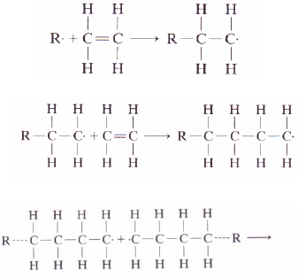
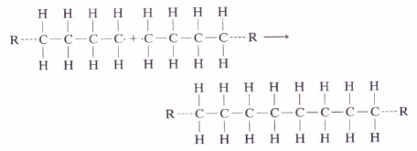

Addition Polymerization
E.g.,
polyethylene
Combination:
Disproportionation:

Slide 45
Condensation Polymerization
It involves more then one monomer species. This process is also known as step growth polymerization.
In condensation polymerization, smaller macromolecule by-product such as water is eliminated.
No resultant product has the chemical formula of mere one monomer.
Repeat unit in condensation process itself is product of polymerization involving basic constituents.
Reaction times for condensation polymerization is usually longer than those for additional polymerization.

Slide 46
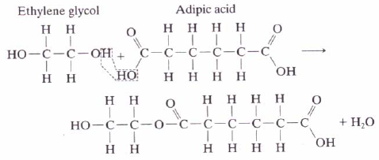
Condensation Polymerization
Formation of a polyester from Ethylene glycol and Adipic acid

Slide 47
Polyesters, phenol-formaldehyde, nylons, polycarbonates etc are produced by condensation polymerization.
Condensation polymerization reactions also occur in sol-gel processing of ceramic materials.
Polymers, unlike organic/inorganic compounds, do not have a fixed molecular weight. It is specified in terms of degree of polymerization – number of repeat units in the chain or ratio of average molecular weight of polymer to molecular weight of repeat unit.
Contd…

Slide 48
Average molecular weight is however defined in two ways. Weight average molecular weight is obtained by dividing the chains into size ranges and determining the fraction of chains having molecular weights within that range.
Number average molecular weight is based on the number fraction, rather than the weight fraction, of the chains within each size range. It is always smaller than the weight average molecular weight.

Slide 49
IES-2001
The molecular weight of vinyl chloride is 62.5. Thus the molecular weight of a polyvinyl chloride with a degree of polymerization of 20000 is
(a) (b)
(c) (d)
Notes:
Ans. (c)

Slide 50
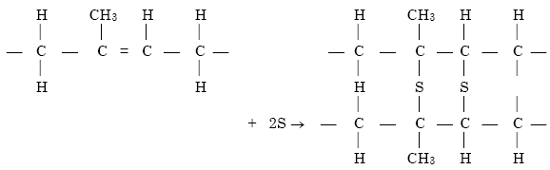
Cross linking: The cross-linking can occur due to the presence of some elements called vulcanizing agents, e.g. S, Se, Te, and O₂.
In case of poly isoprene (natural rubber), the sulphur bridges are formed between two macromolecules during vulcanization.
In this vulcanization process sulphur bridge are formed at the point of opening of double bonds. If the number of cross-links is small; the find product is soft and flexible. The stiffness of the polymeric material increases with the density of cross-lines. When the sulphur content in rubber is as high as 32 weight percent, the hard product is called ebonite.

Slide 51
IES-2003
In the case of rubber, vulcanization refers to the process of producing a
(a) Linear polymer
(b) Branched polymer
(c) Cross-linked polymer
(d) Net-work polymer
Notes:
Ans. (c) An elastomer is produced by heating raw rubber with sulphur. Sulphur forms covalent bonds with the carbon, by saturating the remaining double bond in each monomer. This reaction, known as vulcanization, produces additional link between chains called cross links.

Slide 52
IES-2006
Assertion (A) In Addition Polymerization method, polymer is produced by adding a second monomer to the first, then a third monomer to this dimmer and so on.
Reason (R): There must exist at least one double bond in the monomer for Addition Polymerization reaction.
(a) Both A and R are individually true and R is the correct explanation of A
(b) Both A and R are individually true but R is not the correct explanation of A
(c) A is true but R is false
(d) A is false but R is true
Notes:
Ans. (a)

Slide 53
IES-2000
Assertion (A): Addition polymerization is a primary summation of individual molecules into long chains,
Reason (R): In addition polymerization, the reaction produces a small molecule as by-product.
(a) Both A and R are individually true and R is the correct explanation of A
(b) Both A and R are individually true but R is not the correct explanation of A
(c) A is true but R is false
(d) A is false but R is true
Notes:
Ans. (c)

Slide 54
IES-1994
Which of the following pairs of plastics and their modes of formation are correctly matched?
1. Polythene…………….. Condensation polymerization.
2. Polycarbonate .............Addition polymerisation.
3. Polystyrene………….. .Addition polymerisation.
4. Polyamide …………….Either by addition or by condensation polymerisation.
Select the correct answer using the codes given below:
(a) 1 and 2 (b) 2 and 4
(c) 1 and 4 (d) 3 and 4
Notes:
Ans. (d)

Slide 55
IES-2008
What is the process by which two or more chemically different monomers are polymerised to form a cross link polymer together with a by-product such as water or ammonia, known as?
(a) Addition polymerization
(b) Co-polymerisation
(c) Linear polymerisation
(d) Condensation polymerization
Notes:
Ans. (d)
Condensation polymerization process involves more then one monomer species. This process is also known as step growth polymerization.
In condensation polymerization, smaller macromolecule by-product such as water is eliminated.
No resultant product has the chemical formula of mere one monomer.
Repeat unit in condensation process itself is product of polymerization involving basic constituents.
Reaction times for condensation polymerization are usually longer than those for additional polymerization.

Slide 56
IES-2003
Polyesters can be defined as the condensation products of
(a) Dicarboxylic acids with dihydroxy alcohols
(b) Bisphenol-A and epichloro-hydrin
(c) Phenol and formaldehyde
(d) Benzene and toluene
Notes:
Ans. (a) Polyester resins are quite common. The process often begins with molecules like a dialcohol, and diacid. These then cure into a solid polymer.

Slide 57
Additives to Polymers
The properties of polymers can be further modified by the addition of agents which are basically of two types.
Those that enter the molecular structure are usually called "additives", whereas those that form a clearly defined second phase are called "fillers".
Contd…

Slide 58
1. Plasticizers
Plasticizers are liquids of high boiling point and low molecular weight, which are added to improve the plastic behaviour of the polymer.
They are essentially oily in nature. Organic solvents, resins and even water are used as plasticizers.
Notes:
Plasticizers are liquids of high boiling point and low molecular weight, which are added to improve the plastic behaviour of the polymer.
The broad role of a plasticizer is to separate the macro- molecules, thus decreasing the inter-molecular forces and facilitating relative movement between molecules of the polymer, that is, making deformation easier.
They are essentially oily in nature. Organic solvents, resins and even water are used as plasticizers.

Slide 59
2. Fillers
A filler is used to economize on the quantity of polymer required and/or to vary the properties to some extent, for example, mechanical strength, electrical resistance etc.
A filler, whose function is to increase mechanical strength, is termed a "reinforcing filler".
A filler is commonly fibrous in nature and is chemically inert with respect to the polymer with which it is to be used.
Common fillers are wood flour, cellulose, cotton flock, and paper (for improving mechanical strength); mica and asbestos (for heat resistance); talc (for acid resistance).Other filler materials are : fabric, chipped-wood moulding compound, wood veneer, textile or glass fibres.
The commonly used "reinforcing filler agents" with plastics are : fibres/filaments of glass, graphite or boron.

Slide 60
3. Catalysts:
These are usually added to promote faster and more complete polymerization and as such they are also called 'accelerators' and 'hardeners' e.g., ester is used as a catalyst for Urea Formaldehyde.
4. Initiators:
As the name indicates, the initiators are used to initiate the reaction, that is, to allow polymerization to begin. They stabilize the ends of the reaction sites of the molecular chains. H2O2 is a common initiator.
5. Dyes and Pigments:
These are added, in many cases, to impart a desired colour to the material.

Slide 61
6. Lubricants:
Lubricants are added to the polymers for the following purposes : to reduce friction during processing, to prevent parts from sticking to mould walls, to prevent polymer films from sticking to each other and to impart an elegant finish to the final product. Commonly used lubricants include : oils, soaps and waxes.
7. Flame retardants:
Most plastics will ignite at sufficiently high temperatures. The non-inflammability of the plastics can be enhanced either by producing them from less inflammable raw materials or by adding "flame retardants". The common flame retardants are : compounds of chlorine, bromine and phosphorous.

Slide 62
8. Solvents:
Solvents are useful for dissolving certain fillers or plasticizers and help in manufacturing by allowing processing in the fluid state, For example, alcohol is added in cellulose nitrate plastics to dissolve Camphor. However, subsequently, the solvents must be removed by evaporation.
9. Stabilisers and anti-oxidants are added to retard the degradation of polymers due to heat, light and oxidation.
10. Elastomers are added to plastics to enhance their elastic properties.
Note: Above, excepting fillers, all other materials used, fall under the category of "Additives“.

Slide 63
IES-1992
Fillers are added to plastics to
(a) Improve flow
(b) Reduce brittleness
(c) Facilitate process ability
(d) Reduce cost
Notes:
Ans. (d)

Slide 64
IAS-2007
Match List I with List II and select the correct answer using the code given below the Lists:
List I List II
(Additive for Polymers) (Purpose)
A. Plasticizer 1. Allows polymerization to begin
B. Filler 2. Colours the material
C. Initiator 3. Acts as internal lubricants
4. Improves strength
Code:A B C A B C
(a) 1 4 3 (b) 3 2 1
(c) 1 2 3 (d) 3 4 1
Notes:
Ans. (d)

Slide 65
IAS-1998
Match List- I (Name of moulding composition to prepare plastics) with List-II (Property of moulding composition) and select the correct answer using the codes given below the lists:
List - I List – II
A. Binder 1. Reduce cost, shrinkage
B. Filler 2. Make the moulding of plastic easier
C. Plasticizer 3. Cellulose derivatives
D. Lubricant 4. Accelerate condensation and polymerization
5. Toughness and resistance to temperature.
Codes: A B C D A B C D
(a) 3 1 2 5 (b) 3 1 5 2
(c) 5 3 1 4 (d) 3 5 l 4
Notes:
Ans. (b)

Slide 66
GATE-2016 (PI)
Which one of the following is a natural polymer?
(a) Cellulose
(b) Nylon
(c) Polyester
(d) Polyvinyl chloride
Notes:
Ans. (a)

Slide 67
IAS 1994
To reduce the consumption of synthetic resins, the ingredient added is
(a) Accelerator
(b) Elastomer
(c) Modifier
(d) Filler
Notes:
Ans. (d)

Slide 68
Plastic Process
The common forms of raw materials for processing plastics into products are :- pellets, granules, powders, sheet, plate, rod and tubing.
Liquid plastics are used especially in the fabrication of reinforced - plastic parts.
Thermoplastics can be processed to their final shape by moulding and extrusion processes.
However, extruding is often used as an intermediate process to be followed by other processes, for example, vacuum forming or machining.

Slide 69
Injection Moulding
The polymer is melted and than forced into a mould.
Thermoplastic pellets melted and melt injected under high pressure (70 MPa) into a mold. Molten plastic takes the shape of the mold, cools, solidifies, shrinks and is ejected.
Molds usually made in two parts (internal and external part).
Use of injection molding machine mainly used for thermoplastics (gears, cams, pistons, rollers, valves, fan blades, rotors, washing machine agitators, knobs, handles, camera cases, battery cases, sports helmets etc…)
Contd…

Slide 70
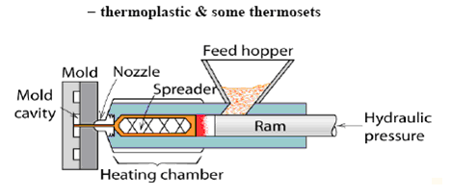
Fig. Injection moulding

Slide 71
Video

Slide 72
Extrusion
Long plastic products with uniform cross sections are readily produced by the extrusion process.
Thermoplastic pellets & powders are fed through a hopper into the barrel chamber of a screw extruder. A rotating screw propels the material through a preheating section, where it is heated, homogenized, and compressed, and then forces it through a heated die and onto a conveyor belt.
As the plastic passes onto the belt, it is cooled by jets of air or sprays of water which harden it sufficiently to preserve its newly imparted shape.
It continues to cool as it passes along the belt and is then either cut into lengths or coiled.
Contd…

Slide 73
The process is continuous and provides a cheap and rapid method of moulding.
Common production shapes include a wide variety of solid forms, as well as tubes, pipes, and even coated wires and cables.
Fig. Extrusion

Slide 74
Video

Slide 75
Compression moulding
A compression mould is made of two halves with one each being connected to the platens of the press.
The mould is electrically heated to maintain the required temperature.
Material is placed in the mould, and it is closed with a hydraulic cylinder, or toggle clamp.
The pressure maintained on the material is of the order of 14 to 40 MPa of moulding area.
As the material comes in contact with the heated mould surface, it softens and fills the entire cavity and at the same time initiates the chemical reaction which cures the part.
Contd…

Slide 76
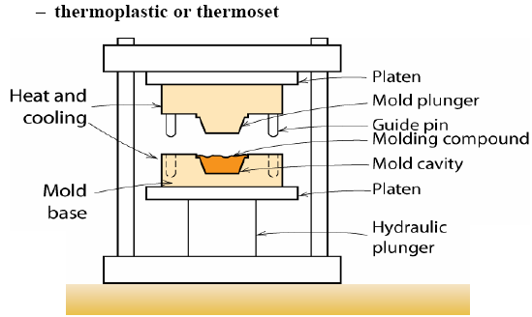
Cure time is determined by the thickest cross section, mould temperature, material type and grade.
After curing, the mould opens and the part is ejected.
The most widely used plastic is phenol- formaldehyde, commonly known as 'Bakelite’.

Slide 77
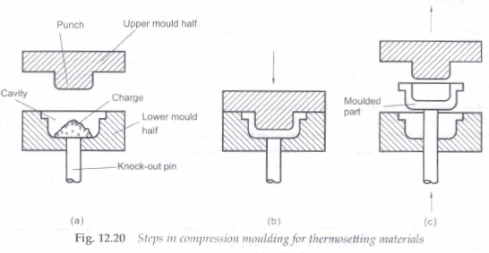

Slide 78
Transfer Moulding
Transfer moulding is very similar to compression moulding and is developed to avoid the disadvantages found in that process.
In this method, thermosetting charge is heated and compressed in a separate chamber and then injected into the closed mould where it is allowed to cool and solidify.
Transfer moulding is capable of moulding part shapes that are more intricate than compression moulding but not as intricate as injection moulding.
Contd…

Slide 79
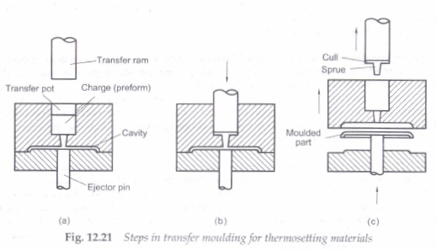

Slide 80
Blow moulding
Blow moulding is the process of inflating a hot, hollow, thermoplastic preform or parison inside a closed mould so that its shape conforms to that of the mould cavity.
Typical parts made are bottles, toys, air ducts of automobiles, chemical and gasoline tanks, and a number of housholds goods.
Contd…

Slide 81
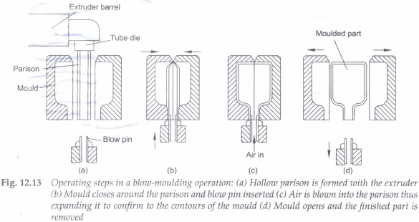

Slide 82
Blow Moulding Video

Slide 83
IES-2005
Thermoplastic materials cannot be produced by:
(a) Injection moulding process
(b) Extrusion process
(c) Blow moulding process
(d) Both (a) and (b) above
Notes:
Ans. (b) For thermoplastic extrusion we have to feed thermoplastic pellets or powders through a hoper into a barrel chamber of a screw extruder. So it is not conventional extrusion process.

Slide 84
Thermoforming
In this process, a thermoplastic sheet can be formed into a three- dimensional shape by the application of heat and differential pressures.
First, the plastic sheet is clamped to a frame and uniformly heated to make it soft and flowable.
Then a differential pressure (either vacuum or pressure or both) is applied to make the sheet conform to the shape of a mould or die positioned below the frame.
It is possible to use most of the thermoplastic materials. The starting material is a plastic sheet of uniform thickness.
It is a relatively simple process and is used for making such parts as covers, displays, blister packaging, trays, drinking cups and food packaging.
Contd…

Slide 85
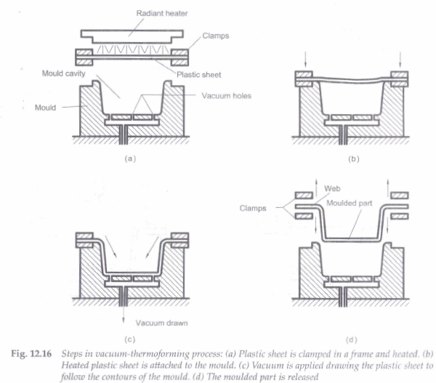
Contd…

Slide 86
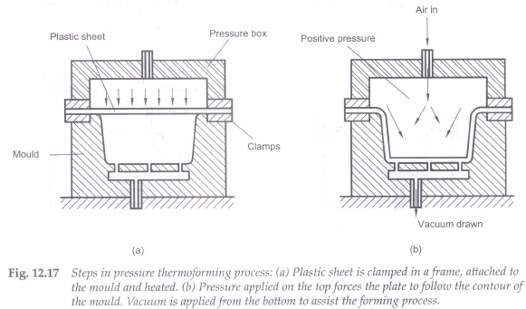

Slide 87
Plastic Sheet Making video

Slide 88
IES-2004
Match List I (Type of moulding) List II (Mechanism involved) and select the collect answer using the codes given below the Lists:
List I List II
A. Compression moulding 1. Mould cavity must be heated to cure the plastic forced into it.
B. Injected moulding 2. Similar to Hydraulic extrusion
C. Jet moulding 3. Analogous to the hot pressing of powered metals
D. Extrusion moulding 4. Analogous to die casting of metals
A B C D A B C D
(a) 2 4 1 3 (b) 3 1 4 2
(c) 2 1 4 3 (d) 3 4 1 2
Notes:
Ans. (d)

Slide 89
IES-2009
Match List-I with List-II and select the correct answer using the code given below the Lists:
List-I List-II
(Article) (Processing Method)
A. Disposable coffee cups 1. Rotomoulding
B. Large water tanks 2. Expandable bead moulding
C. Plastic sheets 3. Thermoforming
D. Cushion pads 4. Blow moulding
5. Calendering
Code: A B C D A B C D
(a) 3 5 1 2 (b) 4 5 1 2
(c) 4 3 2 1 (d) 3 1 5 2
Notes:
Ans. (d)

Slide 90
IAS-1999
Which one of the following are the processes for thermosetting materials?
1. Compression
2. Transfer moulding
3. Injection moulding
4. Extrusion
Select the correct answer using the codes given below:
(a) 1 and 4 (b) 1 and 2
(c) 2 and 3 (d) 2, 3 and 4
Notes:
Ans. (b)

Slide 91
IAS-2007
Which one of the following statements is not correct?
(a) In injection die moulding, exact amount of material to fill the cylinder is delivered
(b) Injection die moulding is generally limited to forming thermoplastic material
(c) Thermosetting plastics are more suitable for extrusion moulding
(d) Extrusion moulding process is used for giving shapes, such as rods, tubes, pipes, ropes etc.
Notes:
Ans. (c) Thermoplastics are made suitable for extrusion moulding.

Slide 92
IAS-2004
Which of the following are the characteristics of the injection moulding of plastics?
1. It is the most economical method of mass producing a single item
2. In most cases finished products are obtained
3. There is lot of waste of thermoplastic since the runners and sprues can not be reused.
Select the correct answer by using the following codes:
(a) 1 and 2 (b) 2 and 3
(c) 1 and 3 (d) 1, 2 and 3
Notes:
Ans. (a)

Slide 93
IAS-2003
Consider the following statements in respect of fabrication of plastic products:
Compression moulding is analogous to hot pressing of powdered metals.
Jet moulding is a modification of compression moulding.
Injection moulding is analogous to die casting of metals
Transfer moulding is similar to hydraulic extrusion.
Which of these statements are correct?
(a) 1 and 2 (b) 1 and 3
(c) 1, 2 and 4 (d) 2, 3 and 4
Notes:
Ans. (c)

Slide 94
IAS-1997
Which of the following processes can be used for mass production of plastic containers (with lid) of 5 liter capacity?
1. Injection moulding
2. Jolt moulding
3. Blow moulding
Select the correct answer using the codes given below:
Codes:
(a) 1 and 2 (b) 2 and 3
(c) 1 and 3 (d) 1, 2 and 3
Notes:
Ans. (c)

Slide 95
IES-2002
Which of the following are fabricated using engineering plastics?
1. Surface plate
2. Gears
3. Guide ways for machine tools
4. Foundry patterns
Select the correct answer using the codes given below:
(a) 1, 2 and 3 (b) 1
(c) 2, 3 and 4 (d) 1, 2, 3 and 4
Notes:
Ans. (c)

Slide 96
IES-2004
Match List I (Material) with List II (Typical use) and the correct answer using the codes given below the Lists:
List I List II
A. Branched polyethylene 1. Bottles
B. Polyester 2. Textile fibres
C. Polyvinylidene chloride 3. Films for packaging
D. Linear Polyethylene 4. Transparent film
A B C D A B C D
(a) 2 3 4 1 (b) 3 2 1 4
(c) 2 3 1 4 (d) 3 2 4 1
Notes:
Ans. (b)

Slide 97
IES 2011
Assertion (A) : The plastic organic materials can be easily shaped or moulded by mechanical action.
Reason (R): It is widely in use as it can be permanently moulded.
(a) Both A and R are individually true and R is the correct explanation of A
(b) Both A and R are individually true but R is NOT the correct explanation of A
(c) A is true but R is false
(d) A is false but R is true
Notes:
Ans. (d) Plastic materials cannot easily shaped or molded by mechanical Action but you need heat. Theromoset also a plastic, can you mechanically form it? (A) is wrong.

Slide 98
The End

